Slide 1
Serological test

Slide 2
Immunoglobulins
also known as antibodies, are glycoprotein molecules produced by plasma cells (white blood cells). They act as a critical part of the immune response by specifically recognizing and binding to particular antigens, such as bacteria or viruses, and aiding in their destruction.

Slide 3
Immunoglobulin classes
1-Immunoglobulin A (IgA)is an antibody that plays a crucial role in the immune function of mucous membranes. The amount of IgA produced in association with mucosal membranes is greater than all other types of antibody combined. is the main immunoglobulin found in mucous secretions, including tears, saliva, sweat, colostrum and secretions from the genitourinary tract, gastrointestinal tract, prostate and respiratory epithelium. It is also found in small amounts in blood.

Slide 4
2- Immunoglobulin G (IgG)
is the main type of antibody found in blood and extracellular fluid, allowing it to control infection of body tissues. By binding many kinds of pathogens such as viruses, bacteria, and fungi.
3-Immunoglobulin M (IgM) is the largest antibody, and it is the first antibody to appear in the response to initial exposure to an antigen.
In the case of humans and other mammals that have been studied, the spleen, where plasmablasts responsible for antibody production reside, is the major site of specific IgM production.

Slide 5
4-Immunoglobulin E (IgE) parasitic worms, including Schistosoma mansoni, Trichinella spiralis, and Fasciola hepatica, Plasmodium falciparum. IgE may have evolved as a defense to protect against venoms.
IgE also has an essential role in type I hypersensitivity, which manifests in various allergic diseases, such as allergic asthma, most types of sinusitis, allergic rhinitis, food allergies, and specific types of chronic urticaria and atopic dermatitis.

Slide 6
5-Immunoglobulin D
In B cells, the function of IgD is to signal the B cells to be activated. By being activated, B cells are ready to take part in the defense of the body as part
of the immune system.
Advantages of serological tests:
1-Determination of different serotypes of the microorganisms or their antigenic structures (bacterial ,parasitic ,protozoal and viral diseases)
2-detection on antibodies present in serum using an antigen–antibody reaction.

Slide 7
The complement fixation test
is an immunological medical test that can be used to detect the presence of either specific antibody or specific antigen in a patient's serum.
Note ; Often non-specific
Materials:
1. Wasserman's tubes.
2. Known standard antigen suspension.
3.Patient's serum (heated at 55˚c for 30 minutes to destroy the complement).
4.Complement1 (fresh serum of guinea pigs).
Procedure:
1.Mix the materials, and incubate in water bath at 37˚c for 30 minutes.
2.Sensitized sheep erythrocytes 5% suspension (as indicator for the fixation of the
complement).
3.Mix, and incubate in the water bath for 30-60 minutes, and read the result
Positive: no hemolysis.
Negative: hemolysis

Slide 8
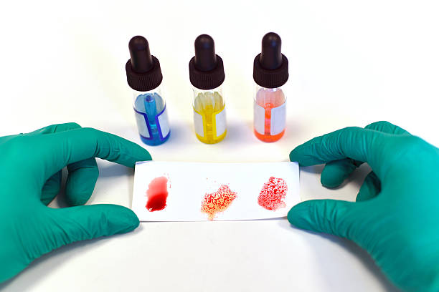
Agglutination type of Tests
Agglutination tests are based on the presence of agglutinating antibodies in patient sera that can react with specific antigens to form visible clumps. In the agglutination tests, the antibody - antigen reaction can be either a direct or passive agglutination reaction.
Note ; visible aggregation of particles and antibodies
(1) Rapid slide method
It is a rapid qualitative test used for the rapid diagnosis and as field test for:
A- Determination of the antigenic structure of bacteria: for
typing different serotypes of Salmonella, E. coli, Pasteurella
multocida, etc.,

Slide 9
Materials:
1. Fat free glass slides.
2. Pure colonies of suspected strain.
3. Diagnostic antisera.
4. Sterile saline.
Technique:
1. Make a suspension of the smooth colonies in saline on one end of the slide,
and on the other end make a control from suspension only.
2. Add 2 drops of corresponding antisera to the suspension.
3. Read the result within one minute after continuous shaking.
B- Whole blood agglutination test: for
Identification of blood group and some poultry diseases.
Materials:
1.Agglutination plate.
2.One drop of fresh blood.
3.Stained antigen.
Result:
1.Clumping and agglutination within one minute is a positive result.
2.Suspension with regular turbidity is a negative result.

Slide 10
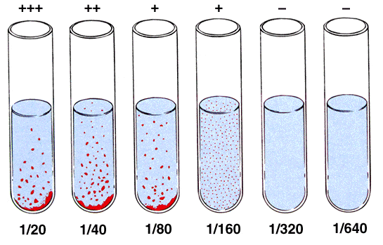
(2) Tube agglutination method "slow method"
It is a quantitative test , It determined the level of Abs in serum ( end titer ),It is used for the diagnosis of typoid fever ,infections abortion , etc .
Materials:
1. Seven agglutination tubes.
2.Sterile pipettes (1 ml and 10 ml).
3.Known standard antigen suspension.
4.Serum from diseased animal.
5.Normal or buffered sterile saline

Slide 11
Technique:
1.0.8 ml of phenol-saline is placed in the first tube and 0.5 ml in each succeeding
tube.
2. 0.2 ml of serum under test in transferred to the first tube and mixed thoroughly
with the phenol-saline already there.
3.0.5 ml of the mixture is carried over to the second tube from which, after
mixing,
4.0.5 ml is transferred to the third tube, and so on
5.continue until the last tube from which, after mixing, 0.5 ml of the serum
dilution is discarded.
6.This process of doubling dilutions results in 0.5ml of dilutions 1:5, 1:10, 1:20,
and so on.
133
7.Add to each tube 0.5 ml of antigen at the recommended dilution and the contents
of the tube are thoroughly mixed, thus giving final serum dilutions of 1:10. 1:20,
etc.
8.The tubes are then incubated at 37˚c for 20 hours ± 1 hours before the results
are read.
9.The result are interpreted as follows

Slide 12
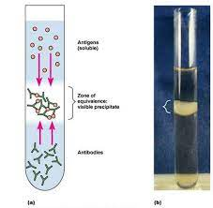
Precipitation Test:
It is used when the antigen is in a colloid state (e.g. toxin or bacterial extract).It is very useful serological test for identifying antigenic substances of all kinds.
The main difference between these two reactions is the size of antigens. For precipitation, antigens are soluble molecules, and for agglutination, antigens are large, easily sedimented particles. ... If an agglutination reaction occurs, shown as clumping of the bacteria, the patient either had or has an S. typhi infection.

Slide 13
ELISA (enzyme-linked immunosorbent assay)
Enzyme-linked immunosorbent assay (ELISA) is a method allowing the quantification of a desired marker in a biological sample. The marker can be an antibody, a hormone, a peptide, or a protein.
Enzyme immunosorbent assay work ;
is a plate-based assay technique designed for detecting and quantifying peptides, proteins, antibodies, and hormones. In ELISA, an antigen must be immobilized to a solid surface and then complexed with an antibody that is linked to an enzyme.

Slide 14
For general ELISA reference only.
For ELISA/EIA kit-specific protocol questions, please refer to the kit instructions, or email techsupport@avivasysbio.com.
100 ul peptide (@4ug/ml) in coating buffer is added to individual wells of a microtiter plate. Incubate the plate for 2 hours at 37C or overnight at 4C.
Remove the coating solution and wash the plate three times by filling the wells with 100 ul PBS-0.05%Tween20. The solutions or washes are removed by flicking the plate over a sink. The remaining drops are removed by patting the plate on a paper towel.
Block the remaining protein-binding sites in the coated wells by adding 100ul blocking buffer, 3% skim milk in PBS per well. Incubate for 1 hour at RT with gentle shaking.
Wash the plate three times with 100ul PBS-0.05% Tween 20.
Add 50 ul of diluted antibody to each well. Incubate the plate at 37C for an hour with gentle shaking.
Wash the plate six times with 100ul PBS-0.05%Tween 20.
Add 50ul of conjugated secondary antibody, diluted at the optimal concentration (according to the manufacturer) in blocking buffer immediately before use. Incubate at 37C for an hour.
Wash the plate six times with 100ul PBS-0.05%Tween20.
Prepare the substrate solution by mixing acetic acid, TMB and 0.03% H2O2 with the volume ratio of 4:1:5.
Dispense 50ul of the substrate solution per well with a multichannel pipe. Incubate the plate at 37C in dark for 15-30mins.
After sufficient color development, add 100ul of stop solution to the wells (if necessary).
Read the absorbance (optical density at 450nm) of each well with a plate reader.

Slide 15
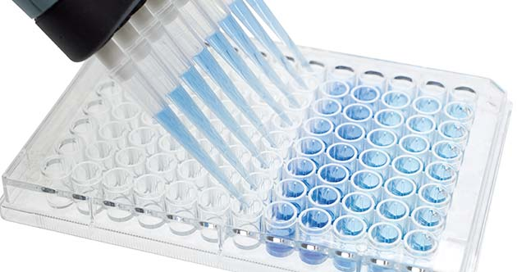
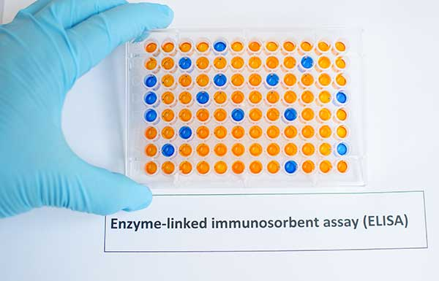
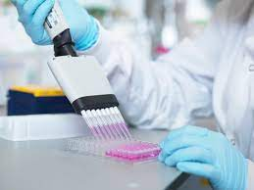

Slide 16
There are different types of Elisa test:
Direct ELISA:
This correlation can be used to extrapolate the concentration of antigen in an unknown sample from a standard curve. Direct ELISA is suitable for determining the amount of high molecular weight antigens.

Slide 17
2-Indirect ELISA Assay
Indirect ELISA is a two-step binding process involving the use of a primary antibody and a labeled secondary antibody.

